Slide 1
Microsoft Student Starter Pack
Speaker: Kenji Phang
Notes:
Hi everyone, welcome to the student meetup event, its nice to see a lot people out on a Tuesday evening joining this event, we only have 20 minutes so without further ado, lets begin the talk

Slide 2

Kenji.Info
Beta Microsoft Learn Ambassador
CS Student from the University of Manchester
Interests: Web Technologies
Doing a placement as a Fullstack Engineer at Interact Software
Notes:
Let me first introduce myself, I’m Kenji, a Microsoft learn student ambassador, I’m studying computer science at the university of Manchester, my interests are in web technologies and I’m currently working as a fullstack engineer at Interact software.
Now, I look like I have a few things under my belt, but really not too long ago, I was quite new to the tech space myself, literally started learning web dev one year ago. I am sure we can all agree that navigating through the tech space can be quite a tricky thing to do, especially as a student. I do quite a lot of programming from my course but every once in a while, I would still feel lost when exploring the world of technology

Slide 3
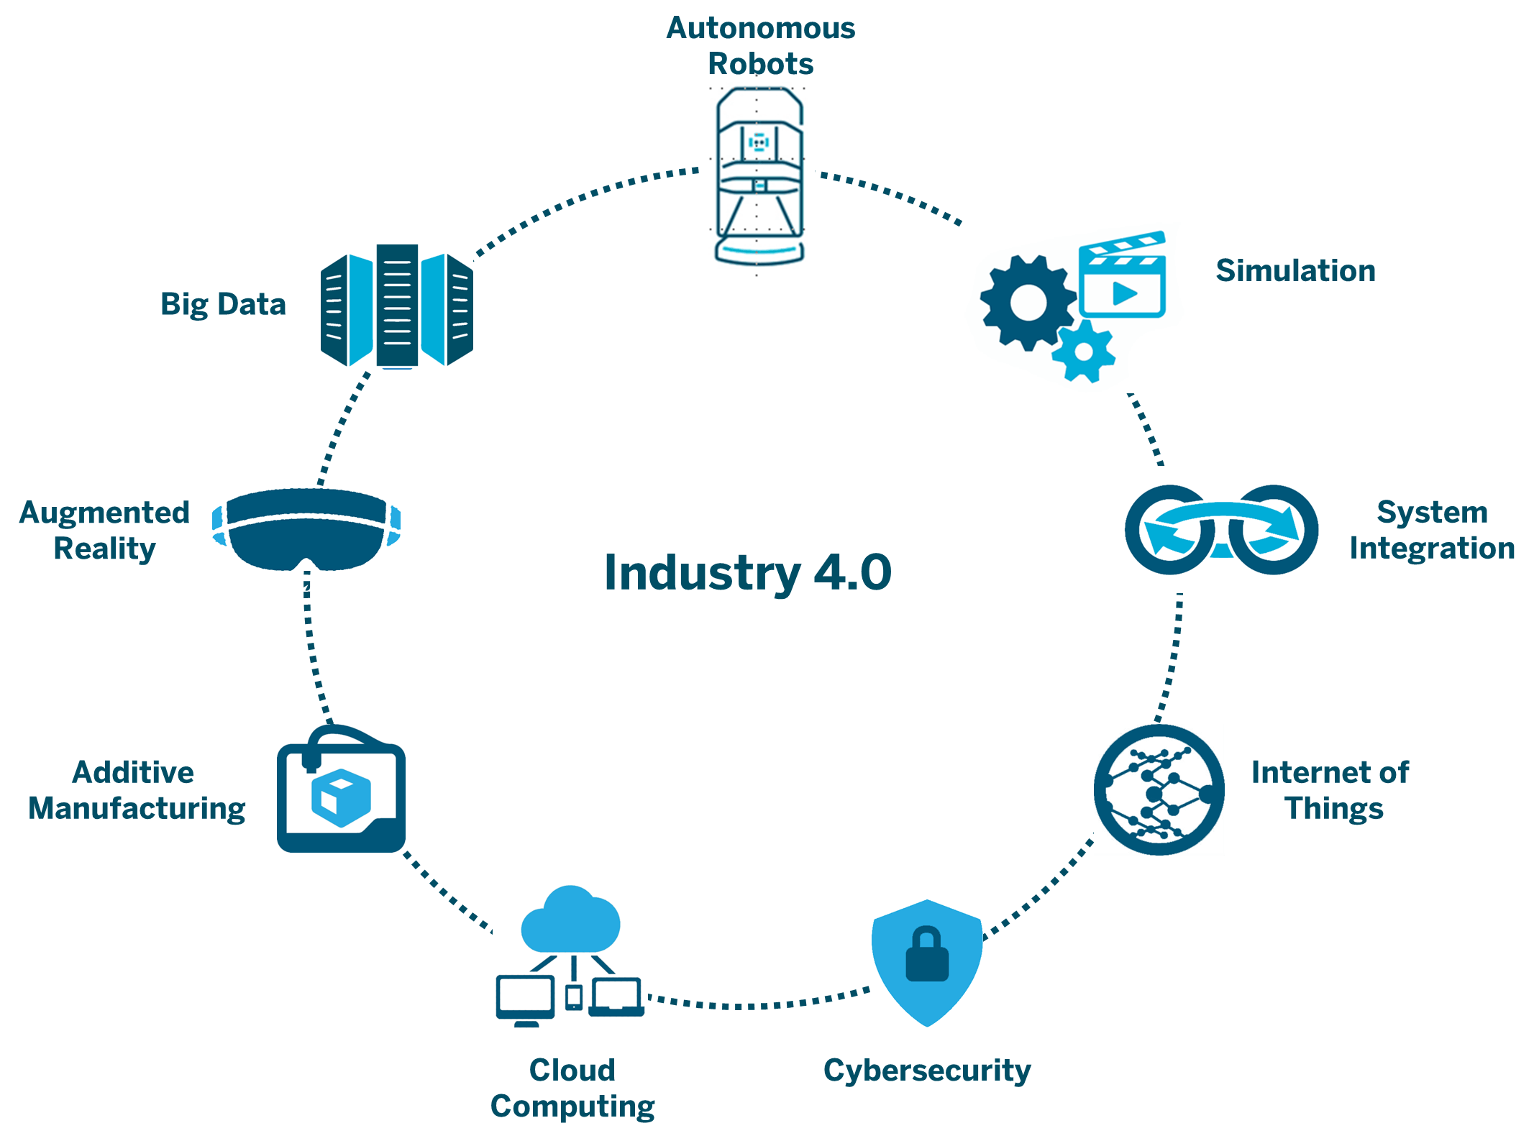
Technology is overwhelming
Notes:
Let’s just dive straight to the problem here, technology is just so overwhelming, it is so overwhelming to the point that universities are even struggling to keep up with the new stuff and because of that, there is now a digital skills gap.
As you can see, we are heading into industry 4.0, there are tons of options we can pursue in tech and its only going to grow even more in the next few years. Diving into the all of this can be very daunting as a student, there is so many things that you can end up doing, How do you find out which field is right for you and where should you even start?

Slide 4
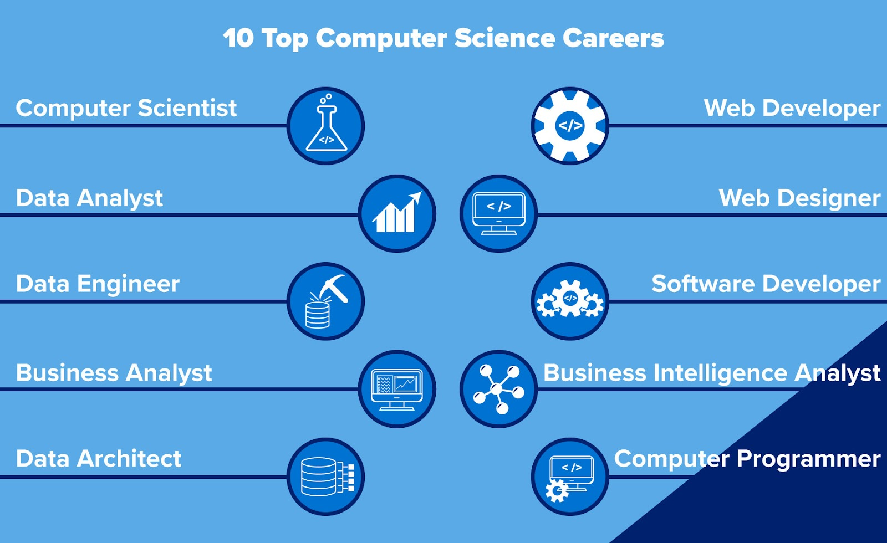
Job roles are overwhelming
Notes:
And its not just that, here is another consideration. Which role is right for you? Do you want to be a developer? A data analyst? As industry progresses, there are just going to be more and more new roles roles in tech. The worst feeling is when you don’t even know that the role exists? I didn’t know what a cloud architects was until I joined the ambassadors programme, I would’ve applied for it but I was so convinced that software engineering was my only route

Slide 5
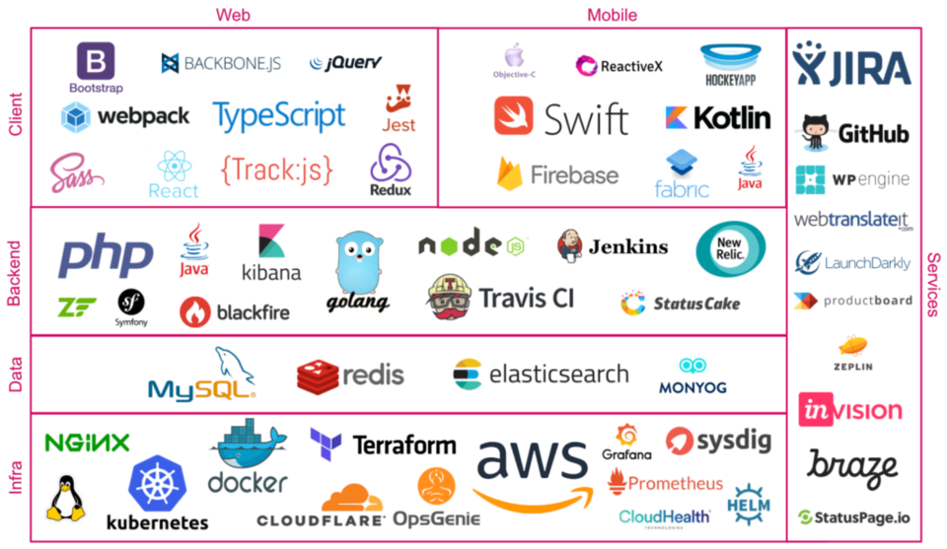
Tech stacks are overwhelming
Notes:
Even after you’ve have decided the field or role, you still have to consider the tools you want to learn. Here are a bunch of tools just for software engineering, and choices in this diagram is really just the tip of the iceberg, newer frameworks are just popping out every few months? Having so many choices just leads to choice paralysis where you’re stuck with choosing and just end up doing nothing

Slide 6
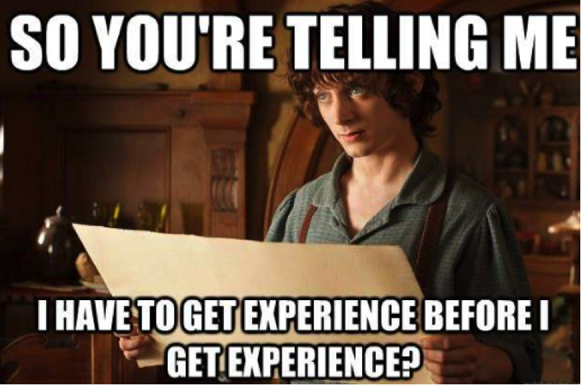
How do I get hired?
Notes:
And finally, you still have to think about how you can get the job itself, you have to be competitive, you need to find ways to make yourself stand out, fill out applications and go through the multiple stages of interviews. If you are a student looking for internships, you have to somehow figure this out even earlier

Slide 7
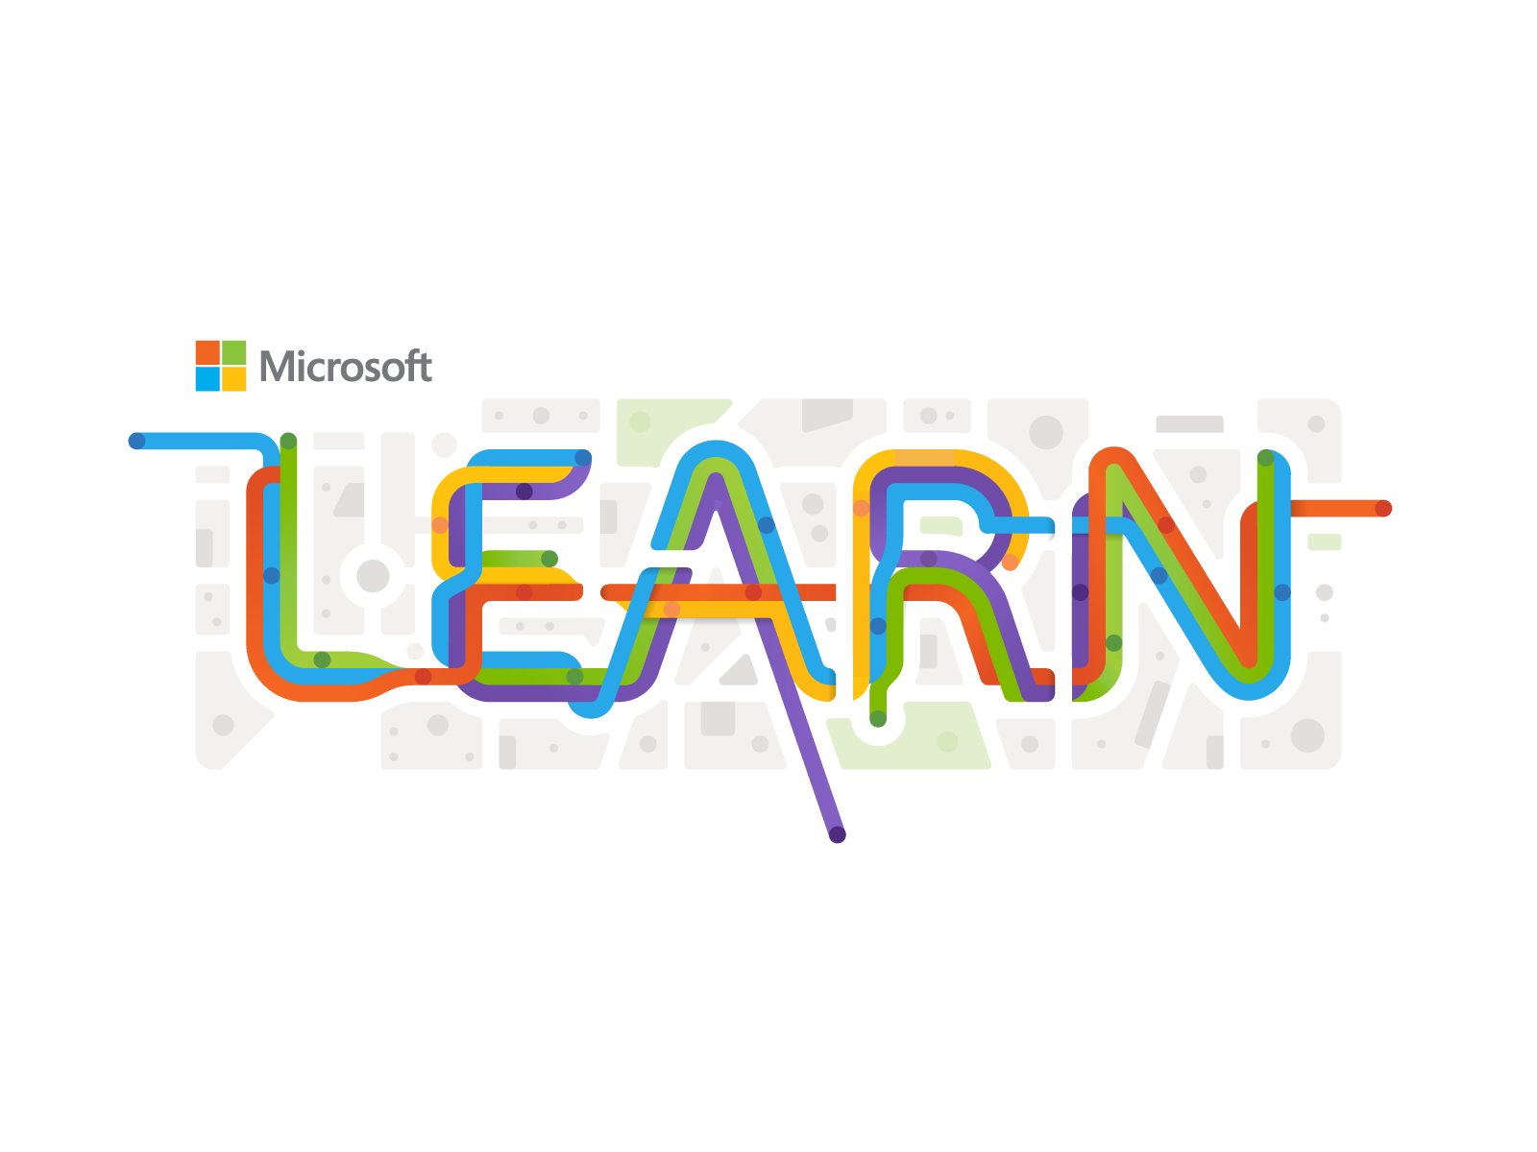


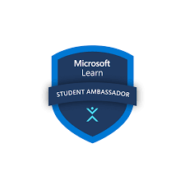



The (unofficial) Microsoft Student Starter Pack
Notes:
I went through all of that myself and all I can say is that it wasn’t easy. To save you all some time and sanity, I want to share with you all what I call the Microsoft student starter pack. This basically consists of the tools, resources and opportunities you students can take advantage of from Microsoft and its subsidiary companies.
Whether you are a new or experienced developer, I’m sure the items here will be useful to you.
Even while making these slides, I found out a lot of things that I wish I knew about earlier, would’ve definitely helped me figure out my path in tech
Also, instead of going through the items one by one, lets use the different stages of job preparations as our narrative and we will see the how each of the items in the pack can help us out at the different stages

Slide 8


What should you do
as a student?
Notes:
So imagine you are a student who is new to technology, what should you do?

Slide 9
Step 1: Acquire Knowledge, Learn Something
Notes:
Well the first step would be to acquire knowledge and learn something

Slide 10
General Learning
Notes:
We can start off by doing some general learning. In the fast and evolving world of tech, there is always something new or something changing everyday, so the first thing we need to do is to do some learning to keep up to date with the latest tech that we currently have, especially since the material taught in university and the stuff used in industry is so different now

Slide 11
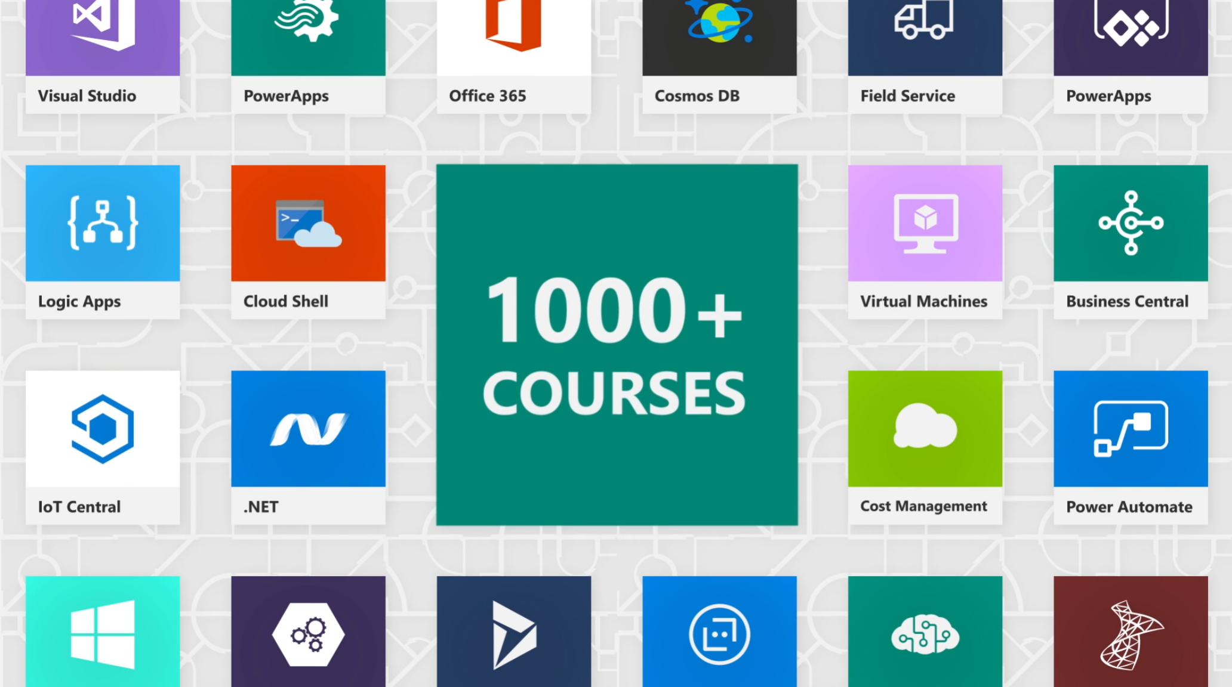
Microsoft Learn
Notes:
And that’s where Microsoft Learn comes in. As the name suggests, its Microsoft’s learning platform, you can learn a variety of topics from general stuff like cloud computing and software engineering to niche stuff like mixed reality and quantum computing.
https://docs.microsoft.com/en-us/shows/one-dev-minute/what-is-microsoft-learn

Slide 12
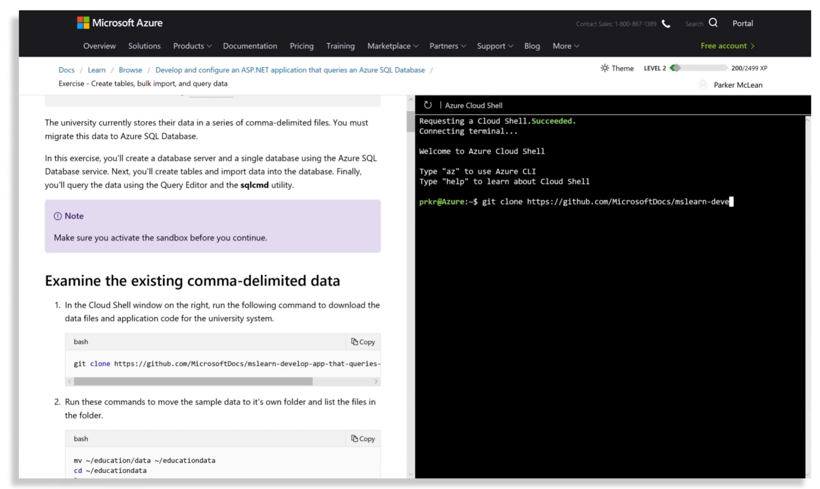
Microsoft Learn
+ Hands on Practice
Notes:
The number one reason you should use Microsoft Learn is for hands on practice. Most of the technical modules provide you with a sandbox environment which is just like the real thing for you to try things out and play around with, if you mess up its all good. This is especially useful for learning the cloud related skills, I don’t think you get hands on practice for free anywhere else, so really take advantage of this

Slide 13
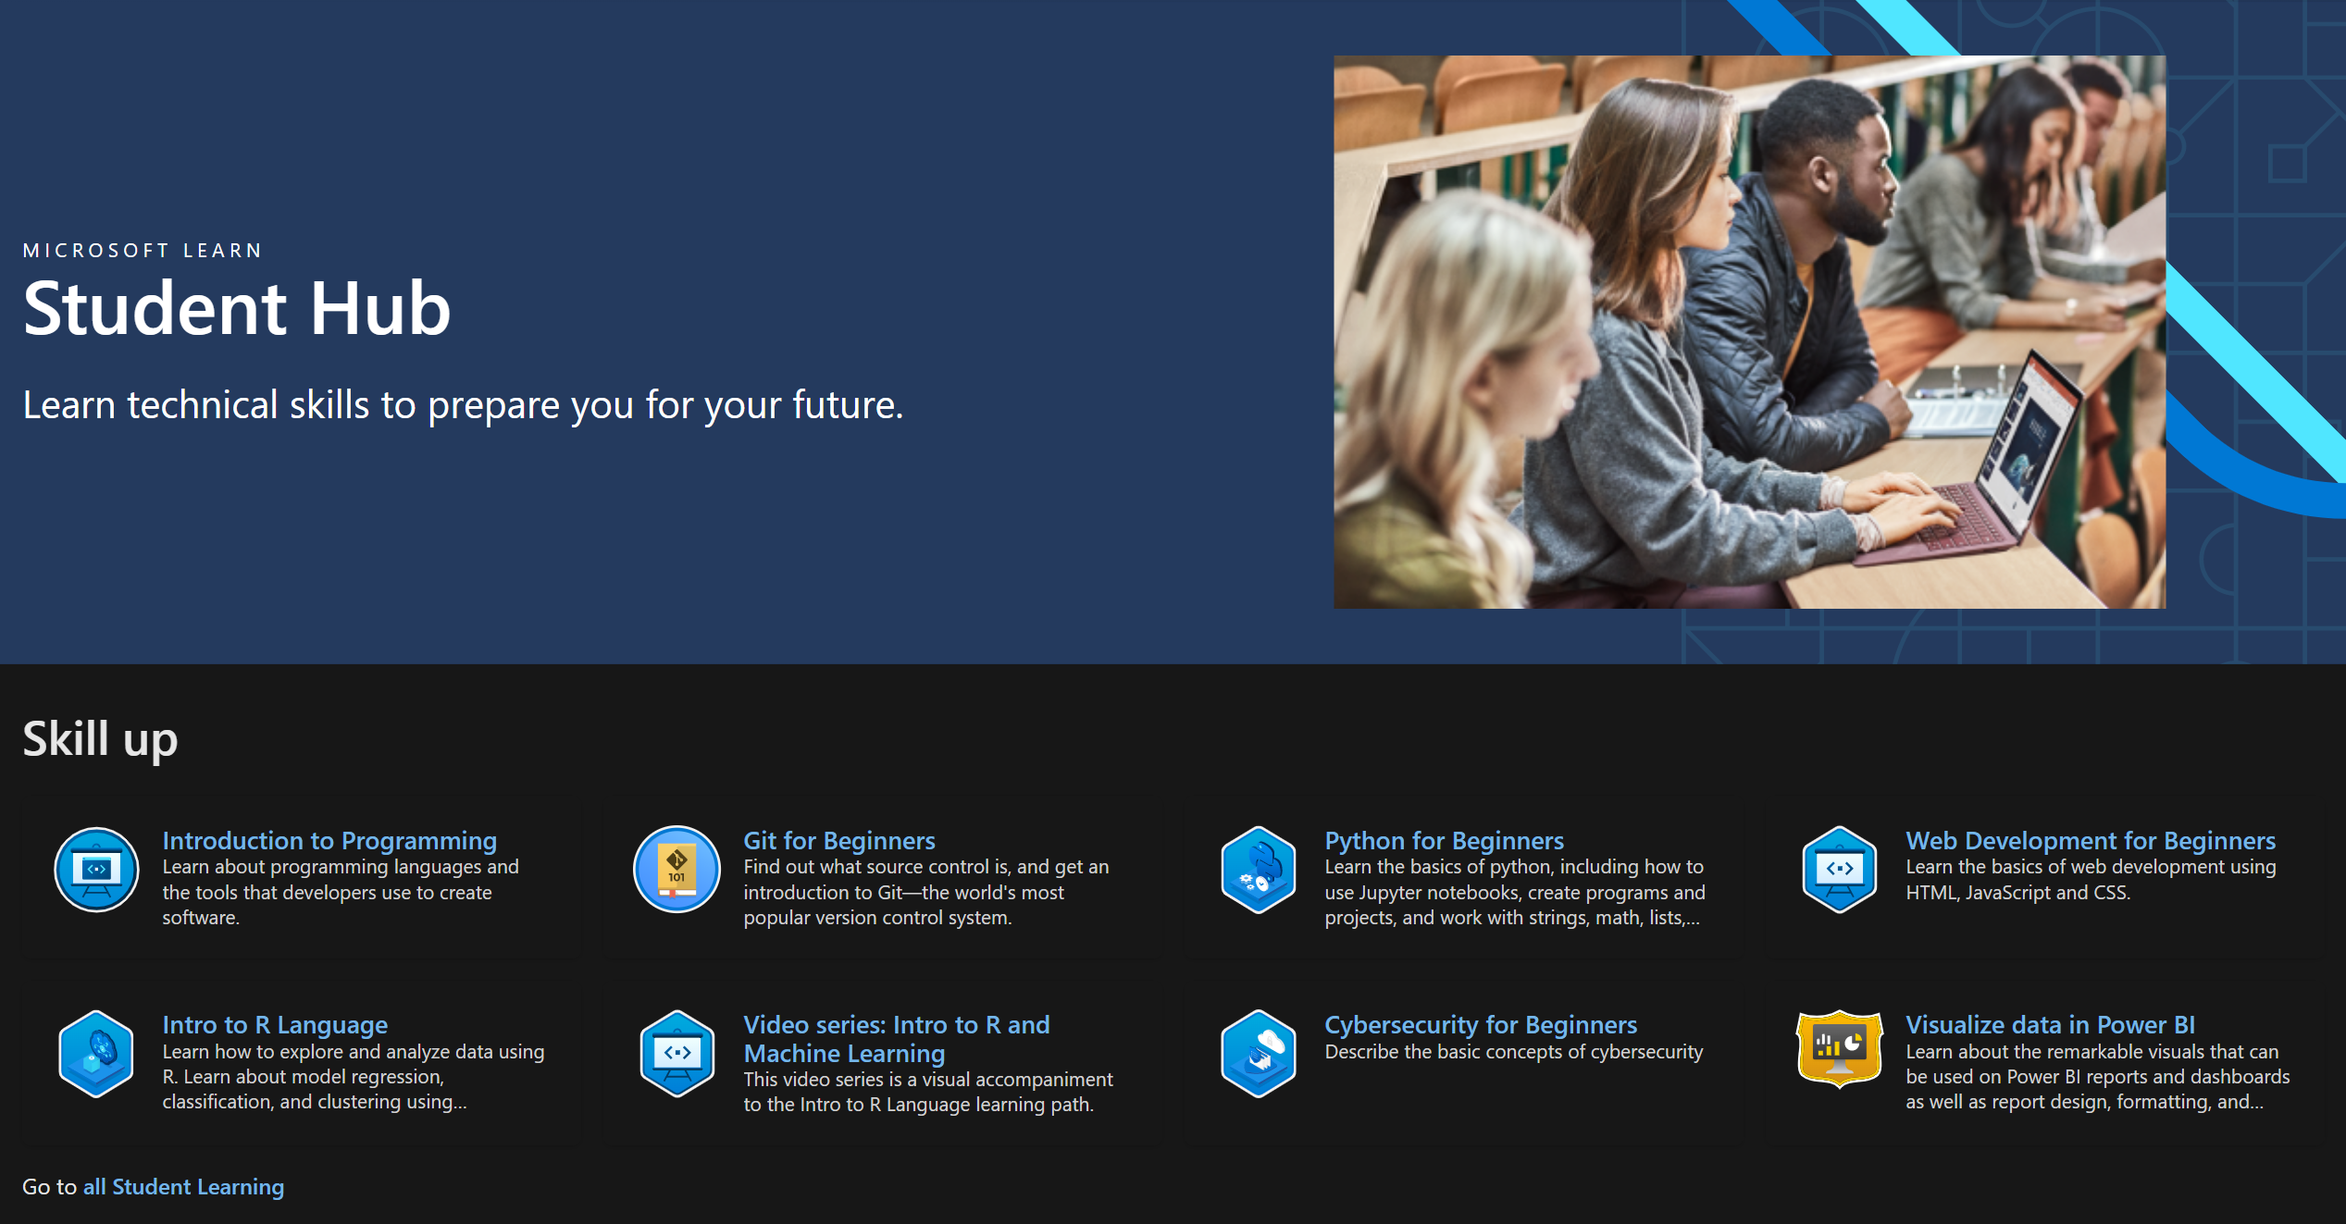
Learn Student Hub
http://aka.ms/learnstudent
Notes:
Check out the learn student hub, it is a one stop resource for all things relevant to students, a lot of the content is in this talk itself. If you are new to tech and need some direction, go through the Learn modules in the skill up section, it should give you the basic skills a developer would need

Slide 14
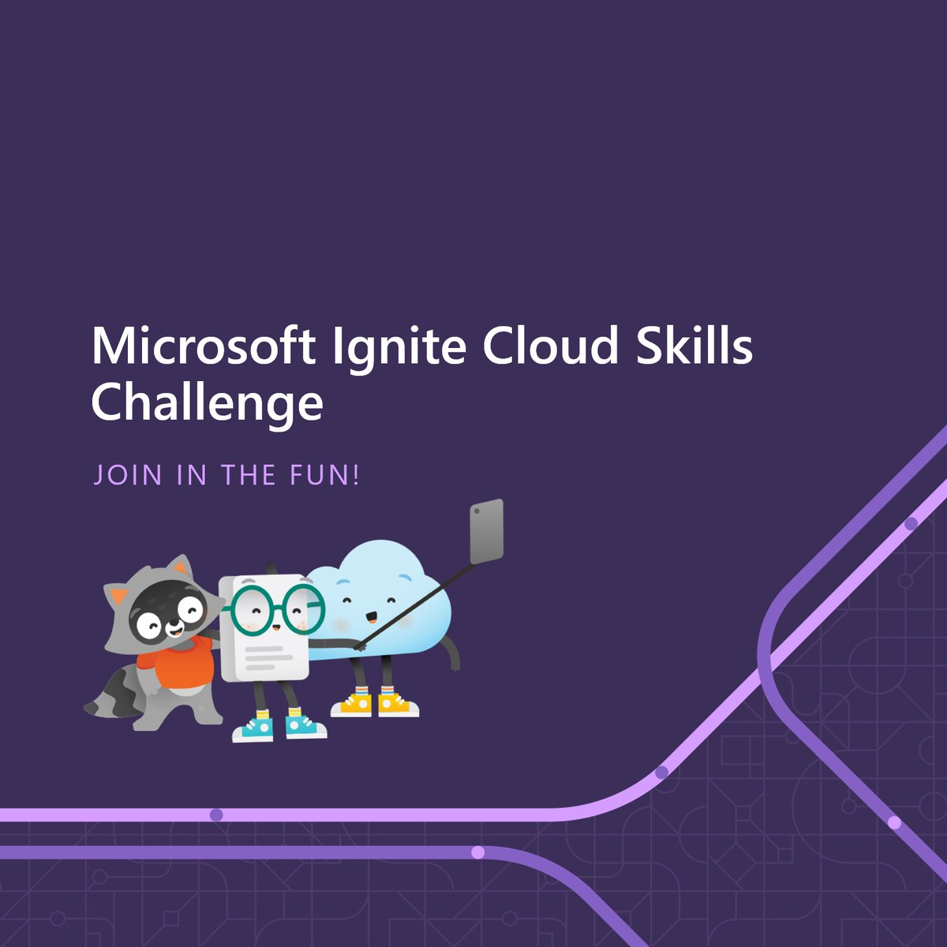
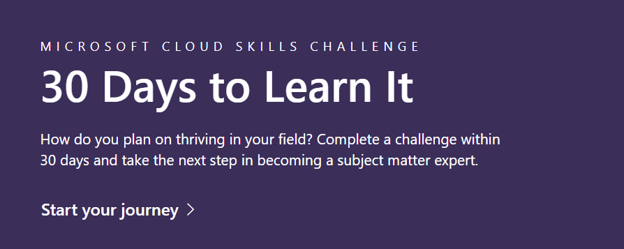

Cloud Skills Challenge
Notes:
Obviously, that’s just some of the bare basics, theres also this 30 days skills challenge that you can check out, search for it,

Slide 15
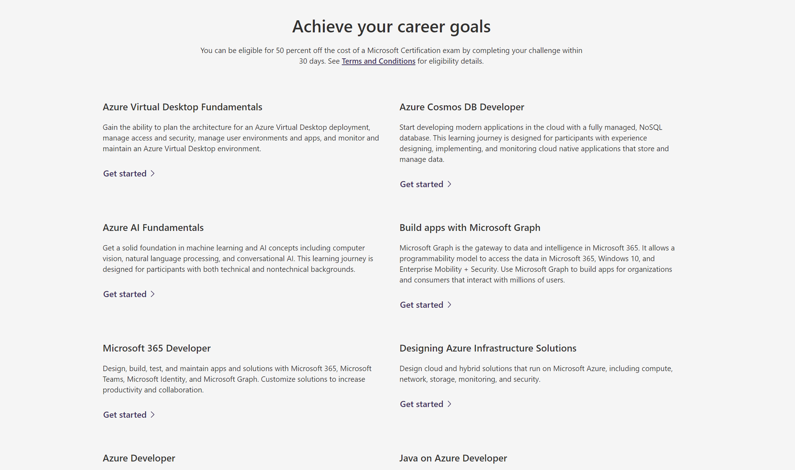
Notes:
they are role based and going through them should give you some introduction to a role and hopefully enough to get you started

Slide 16
Essential skills
Notes:
Next is to learn the essential developer skills, no matter what you end up doing, these skills are nice to have

Slide 17
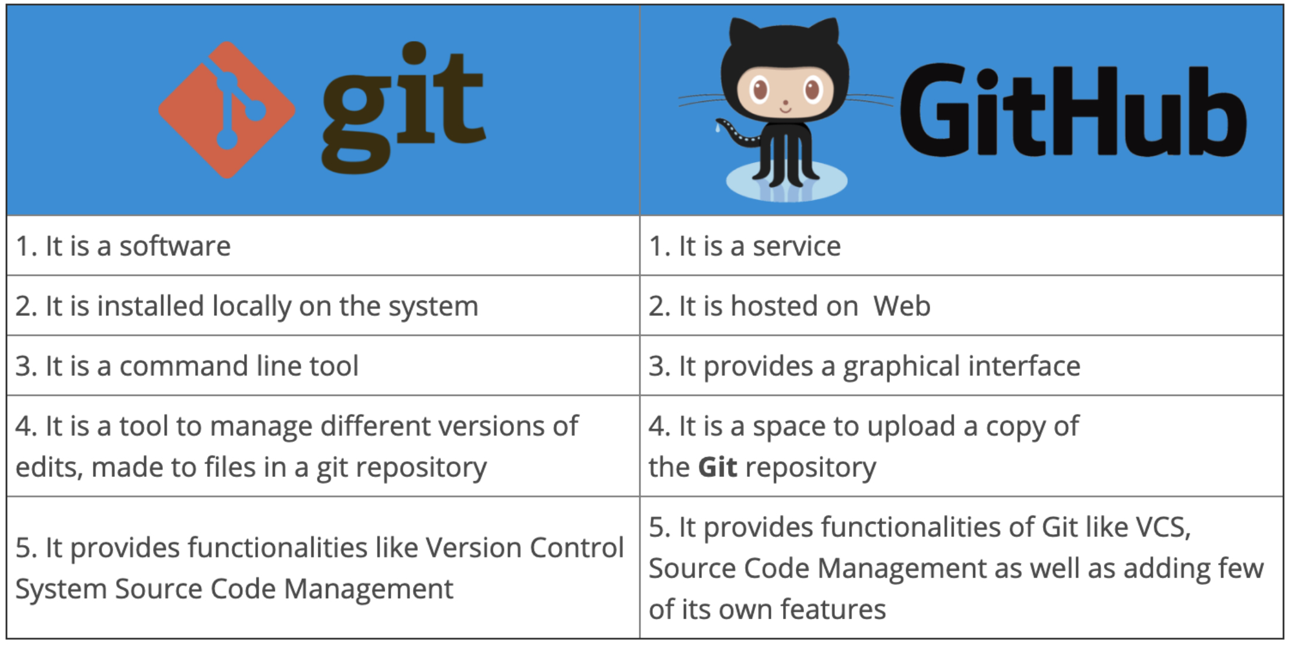
GitHub
Notes:
The first things that comes to mind are Git and GitHub. If you’re confused with them, Git is the source control tool, it lets you collaborate with others to apply changes to a codebase efficiently. GitHub on the other hand is a service provider, they are the ones who host the servers for your code repositories and give you a nice interface to use
If you don’t have a GitHub account yet, create one asap. This is where the code for your projects will live, it is essentially your portfolio, it allows you to showcase your work
Git is also one of the most important skills you will need in doing any sort of development, so please master it as soon as possible, I have seen a lot of people being afraid to merge their code or push changes because they are afraid that they might mess things up, and they waste time waiting for someone else to do if for them.

Slide 18
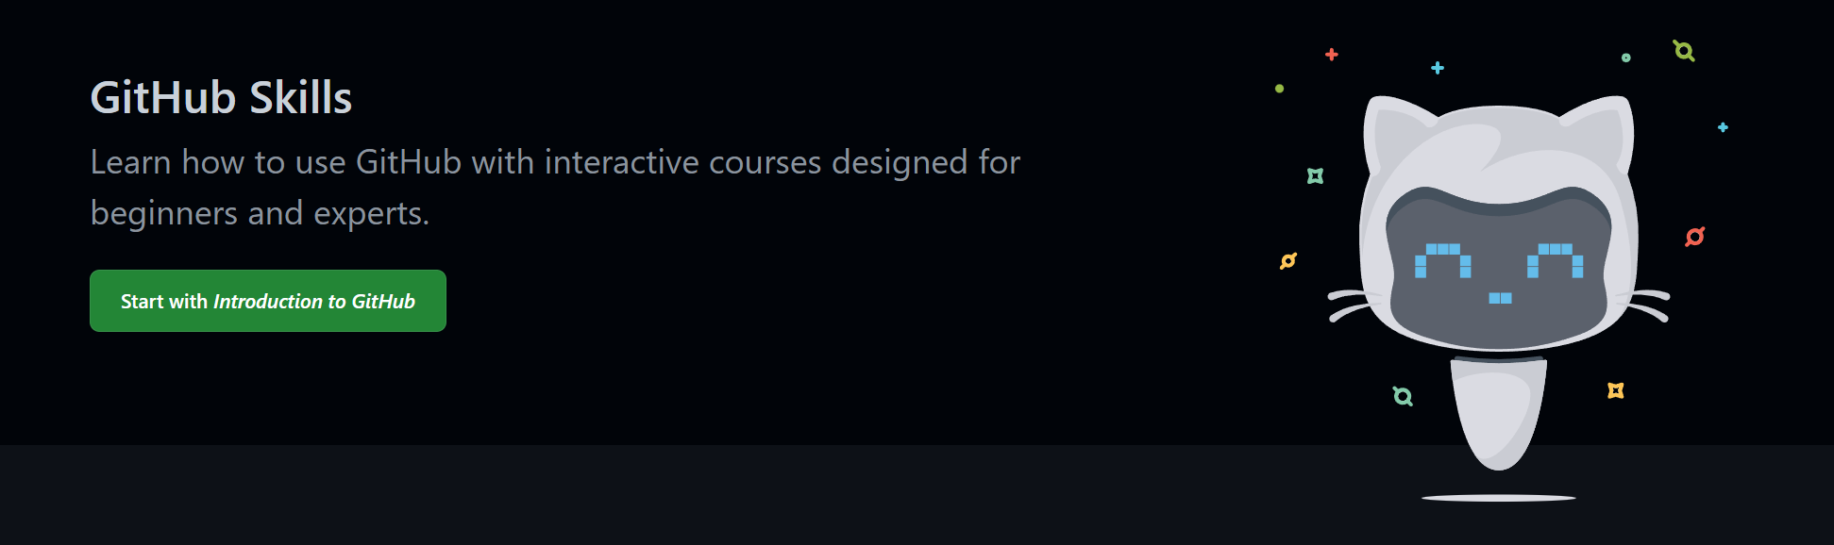
GitHub Skills
Notes:
Conveniently, GitHub has its own learning platform called GitHub Skills. From here, learn the basics of git, how to push changes, how to use branches and how to merge and rebase them, learn about git workflows, and some basic devOps through GitHub actions.
https://skills.github.com/

Slide 19
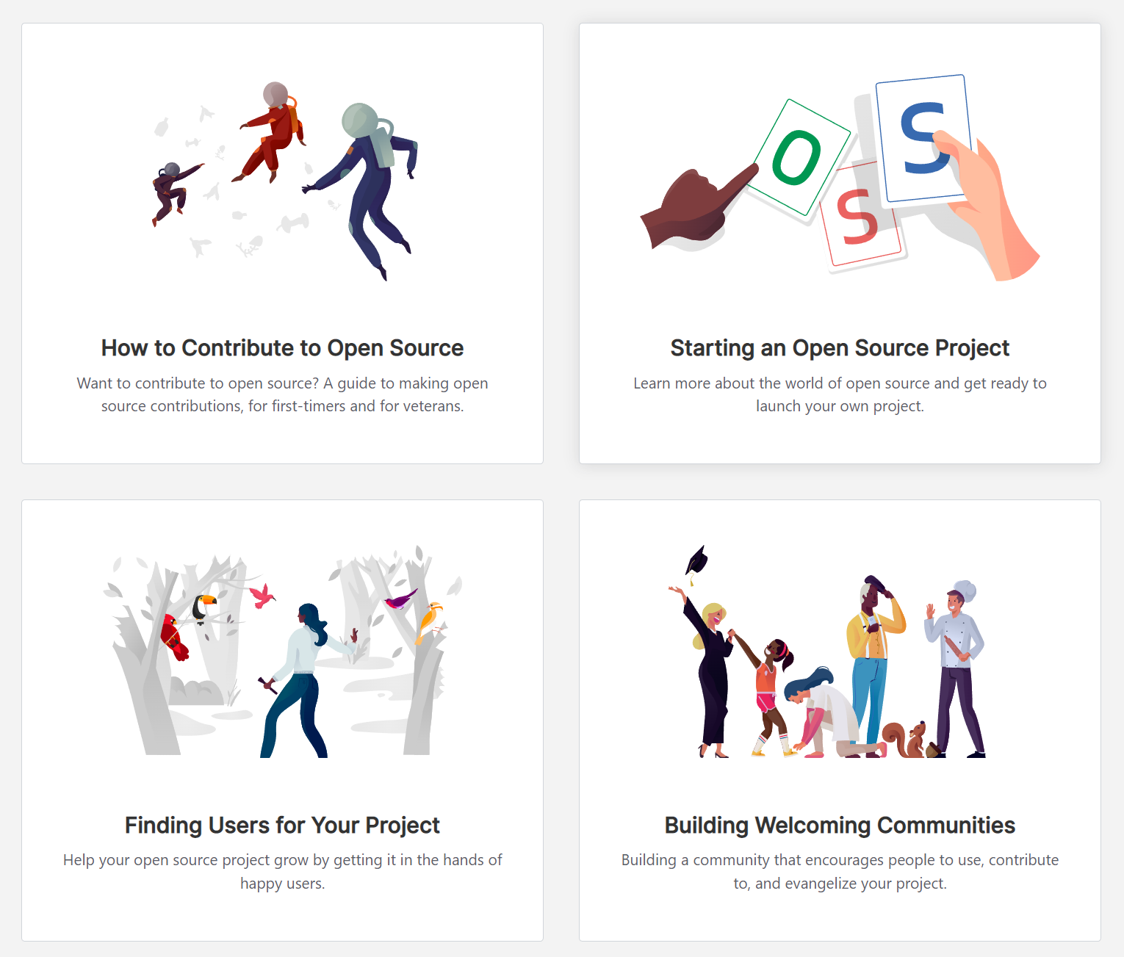
GitHub and Open Source
Notes:
Also, open source is a very popular thing to know about nowadays so learn how open source coding works on GitHub, how to contribute to an open source project, how to start an open source project etc. Also, if you can, try to do some open source contributions, doing them really shows your skills and help you stand out, it shows skillful enough that you are able to work with strangers online and also that you’re giving back to the community, which is a very commendable thing
https://opensource.guide/

Slide 20
Non-technical skills
Notes:
If you want to succeed in the world of tech, technical skills can only get you so far. You also need a balance of non-technical skills, like being able to articulate your thoughts and communicate well, teamwork and planning. Especially when applying for jobs, if you are unable to communicate your thoughts well, its quite hard to even pass the interviews.

Slide 21

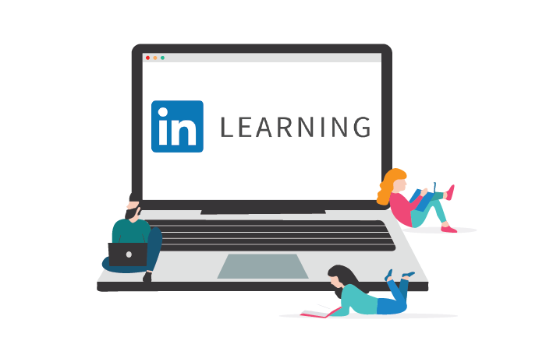
Linkedin Learning
Notes:
For non technical skills, a great place to learn about them is through Linkedin Learning. The courses are mostly video based which I appreciate. There are courses on almost everything from public speaking, event planning and even coding. You normally need to pay quite a sum of money for this service like 30 pounds per month, but I’ll show you how you can potentially get it for free in a later section.
And the courses also usually come with a certificate which you can add to your LinkedIn profile, so it also helps you build your LinkedIn profile at the same time which is important for jobs

Slide 22
Doing Something: Personal Projects
Notes:
You’ve got the knowledge, the next step is to actually do something

Slide 23
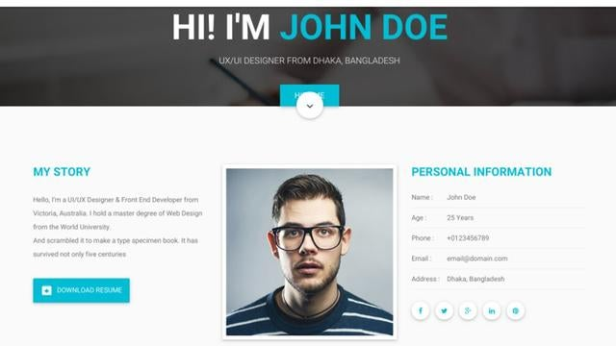
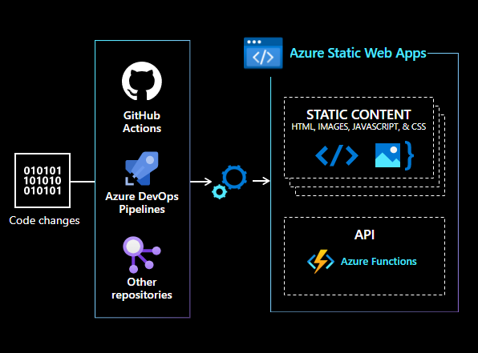
Do Projects and Deploy them
Notes:
Start diving straight into personal projects, if you’re interested in web development, build your own personal website, a blog site etc check out Azure static web apps for these, it lets you deploy your websites easily or if you’re interesting in machine learning make some machine learning model and make sure to deploy it, deploying something online shows that you understand the development process end to end, and you stand out even more if someone ends up using your product

Slide 24
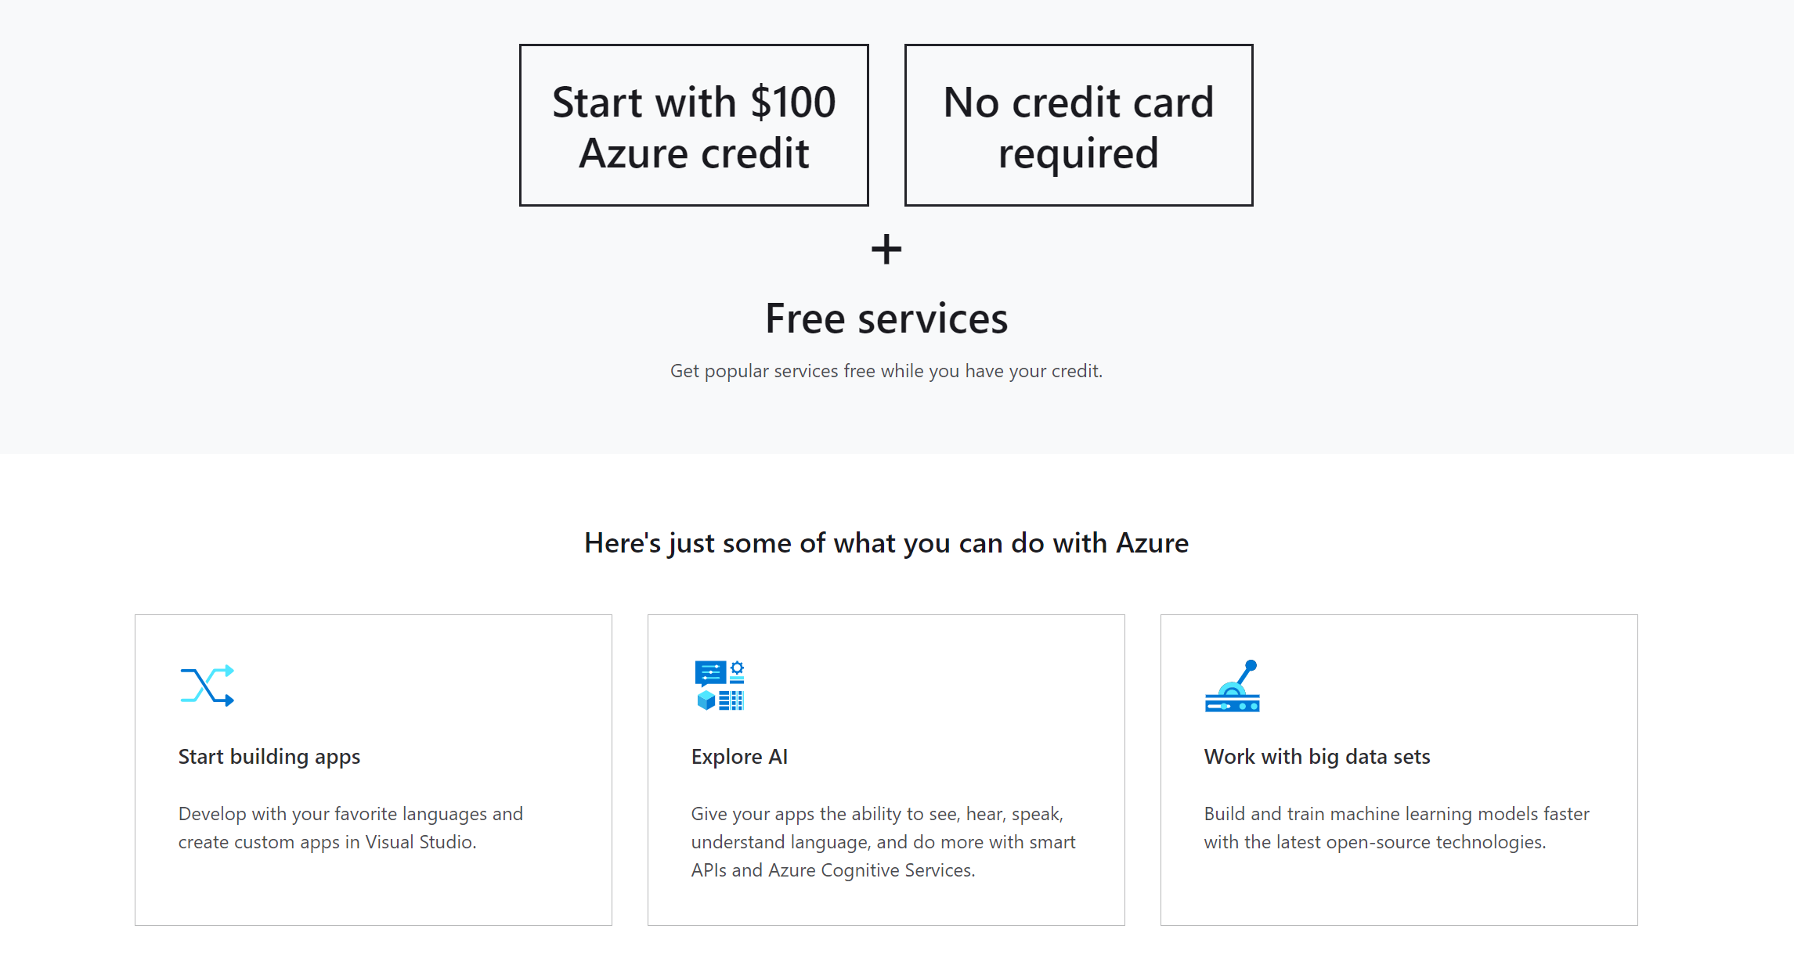
Azure for Students
Notes:
If you’re deploying stuff on Azure and ever need some funds, check out Azure for Students, it is a program where students can get free Azure credits, around 100 USD a year and access to some free services, and it renews every year while you are still a student
This 100 USD and free services should be enough to get whatever projects you have out there, you essentially get free hosting while you are a student

Slide 25
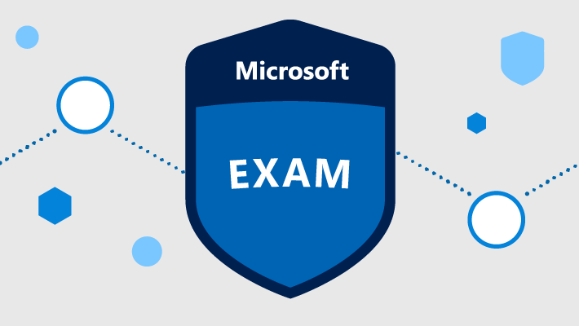
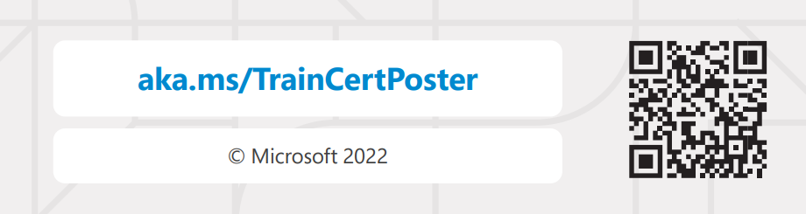
Microsoft Exams for Students
Notes:
To make yourself stand out even more, take a look at the Microsoft Exams. This is a good way to prove that you really have the skills and knowledge. The exams are split into different difficulties, they are role based as well and go hand in hand with the Learn modules, so if you want to take your skills to the next level, just take the exams,
Linkedin has a statistic that you are 2.4x more likely to be hired if you have one of these certs in your profile, so this is quite useful
https://docs.microsoft.com/en-us/learn/student-hub/certifications

Slide 26
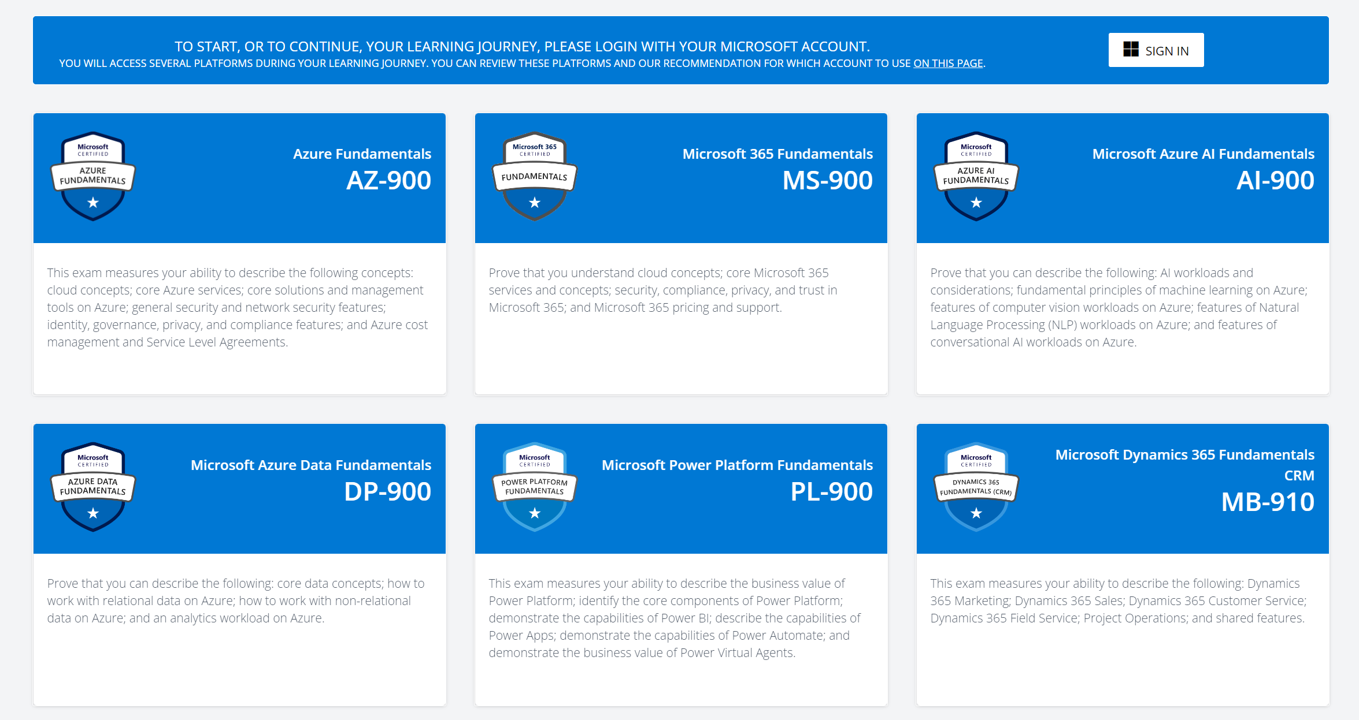
Microsoft Exams for Students
Notes:
The good news here is that all the fundamental exams are currently free for students. You can prepare for the exam through doing the Learn modules, you are provided with the exams practice tests for free, and exam vouchers also for free, you are essentially provided with everything you need to pass, so all that’s left to do is to sit the exams.
I recommend trying out the fundamental exams, on top of getting the recognition, this is a good way of getting that breadth through the tech industry, it really exposes you to the services and job roles in industry, in a sense these exams will keep you up to date with the current technological standards
https://docs.microsoft.com/en-us/learn/student-hub/certifications

Slide 27
Tools and Resources
Notes:
Lets look at the tools and resources that can help you with your projects

Slide 28
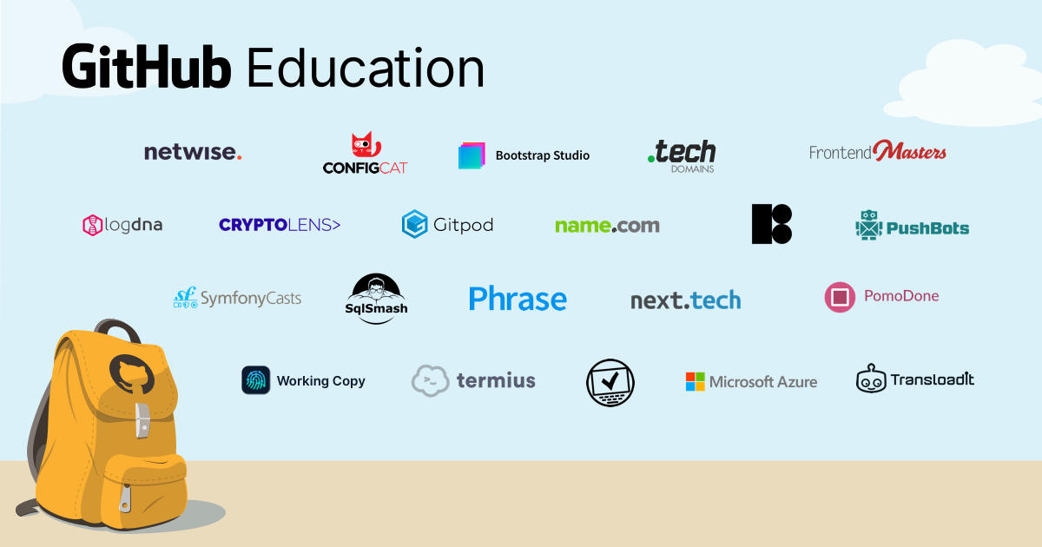
GitHub Education
Notes:
From GitHub, we have GitHub education, if you are a student, you can get
a free GitHub Pro account
the GitHub Student Developer Pack
Connect with GitHub campus experts from your local communities to get some support
https://education.github.com/students

Slide 29
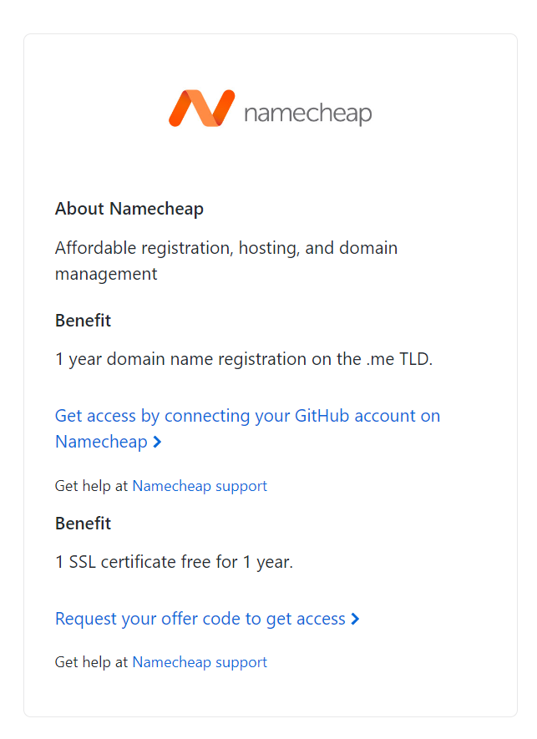
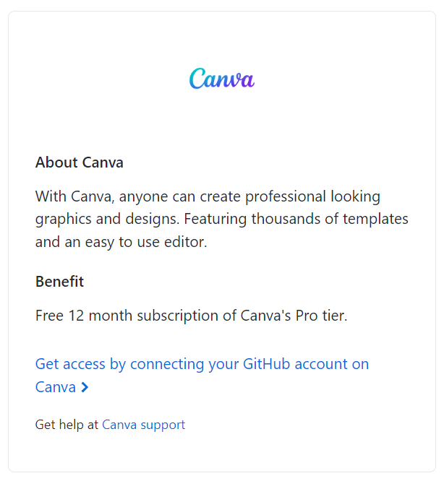
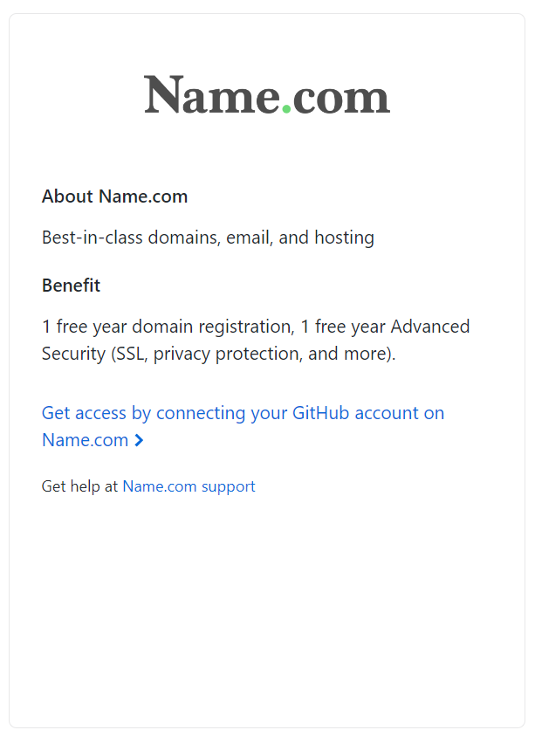
GitHub Student Developer Pack
Notes:
The GitHub student dev pack is a must have as a student, it is just a collection of free stuff for students to enhance the developer experience, so definitely check that out. Here are some things that I think are the very useful. Canva, this is a very useful tool for doing any design work, like infomercials and slides, it just makes it look a lot better.
And free domain names are always nice, use these in conjunction with deploying your websites

Slide 30
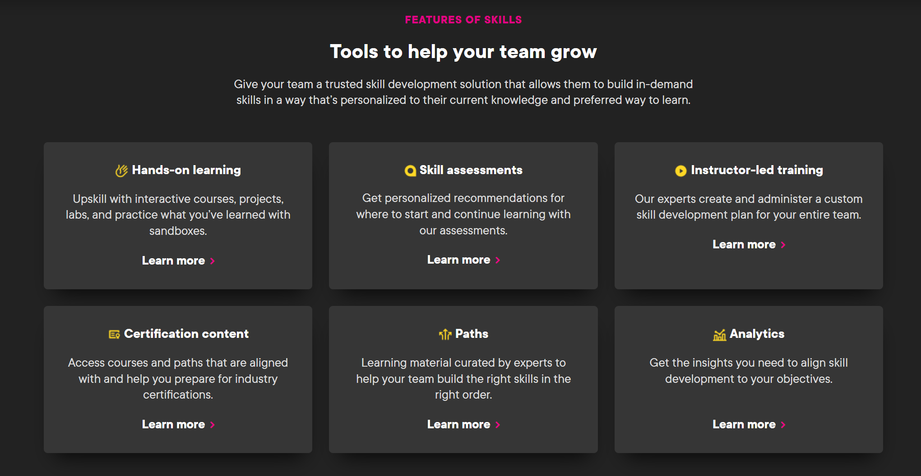
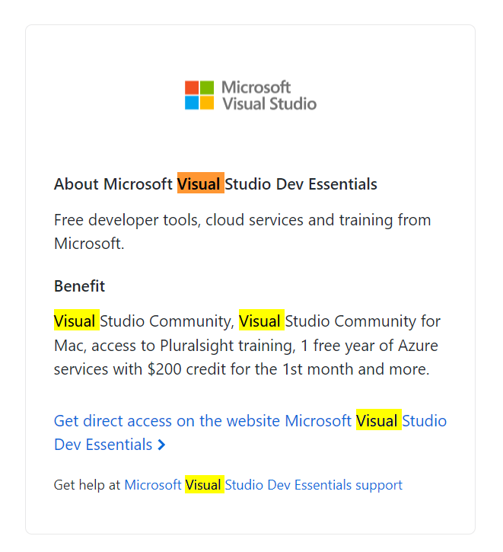
Bonus – PluralSight from Visual Studio Subscription
Notes:
Here is another one that I don’t think many students know about, you can get access to PluralSight through the Visual Studio Dev Essentials, PluralSight is just another amazing learning platform, its more video based and you can learn about almost all of the software or it skills from here

Slide 31
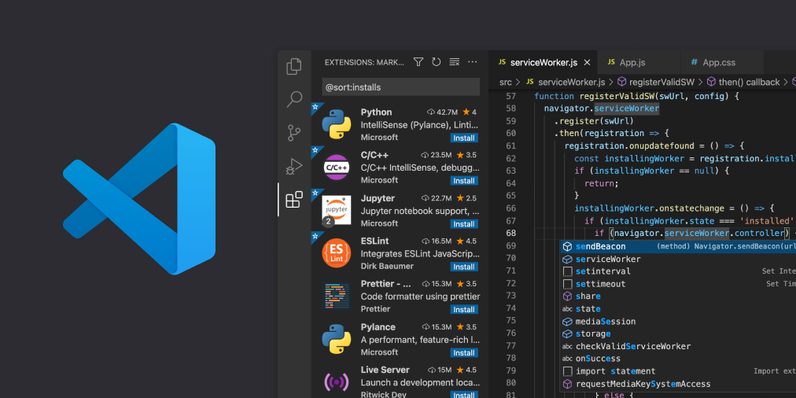
Visual Studio Code
Notes:
Lets move on to the place where you will use to write your code in, Visual Studio Code. Visual Studio Code was originally just a text editor, but it has evolved to become more than just a text editor in the past few years, now you can do almost anything with it
The next talk is about Visual Studio Code so I will skip talking about this one but here are some cool extensions I wanted to share

Slide 32
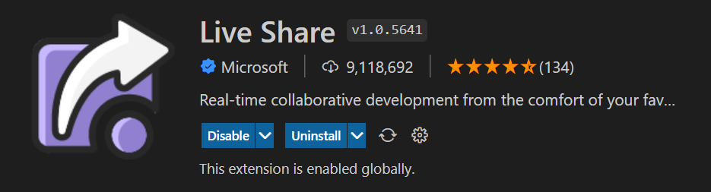
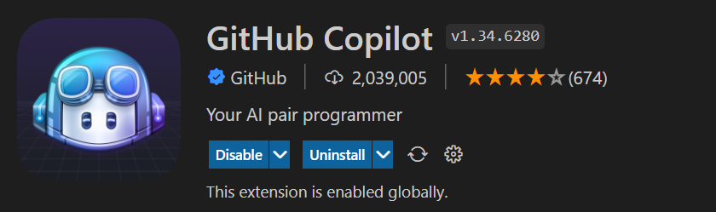
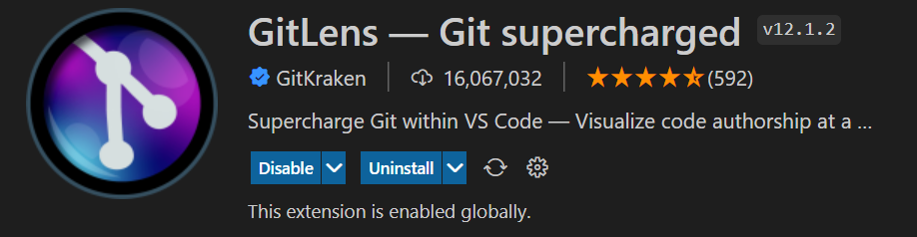
Cool Extensions to have
Notes:
Live Share, it allows you and your collaborators to apply changes to your code in real time
GitHub Copilot, you have an AI buddy which will generate code for your description
Git Lens, it showcases all the git history in line, so you know who to blame for some bad code

Slide 33


Visual Studio
Notes:
While we are here, I wanted to talk a little about Visual Studio. A lot of people get confused between Visual Studio and Visual Studio Code and I don’t blame them, they are meant to be different but VsCode can now do almost everything, so its getting harder to tell the difference.
But Visual Studio is actually a full IDE for you to write software. We usually use it to write .NET applications, it just has a lot more features to maintain and debug large scale software

Slide 34
Do Something: Making Impact
Notes:
Next, lets look at some impact opportunities, these activities give you a chance to apply both technical and non technical skills

Slide 35
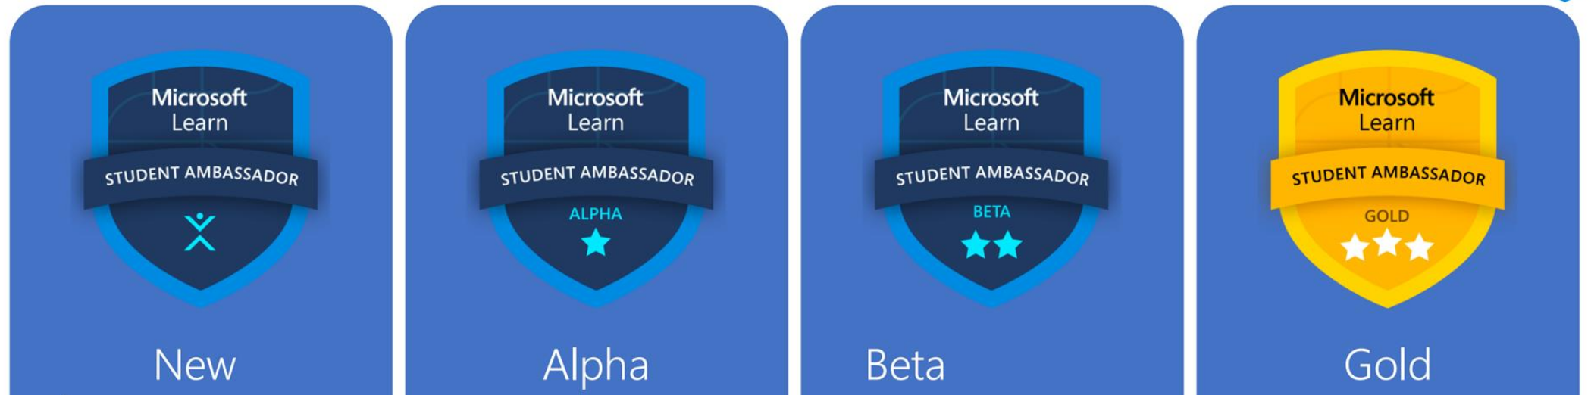
Microsoft Learn Student Ambassadors
+ Mentorship Opportunities
+ Be the first to try out new things, Microsoft Insiders Program
+ Exam Vouchers
+ Social Impact Projects
+ Free LinkedIn Learning when reaching Alpha
+ LinkedIn Premium after running first event
Notes:
First up is the the Microsoft Learn Student Ambassadors.
As a Microsoft learn student ambassador, your main responsibility is to share your knowledge with other people and build tech communities in your local area, doing things like this talk, creating content and contributing to the tech space.
This is a really cool opportunity for students, you will get access to a lot of cool things, like
Mentorship opportunities, there is a peer to peer one and there is one with Microsoft MVPs,
Be first to know about the cool opportunities, recently there was a Microsoft Insider MVP program
More free exam vouchers
Free LinkedIn Learning when reaching Alpha, this is what I was referring to just now
Social Impact Projects
Networking opportunities like this event
Free LinkedIn Premium after running first event

Slide 36
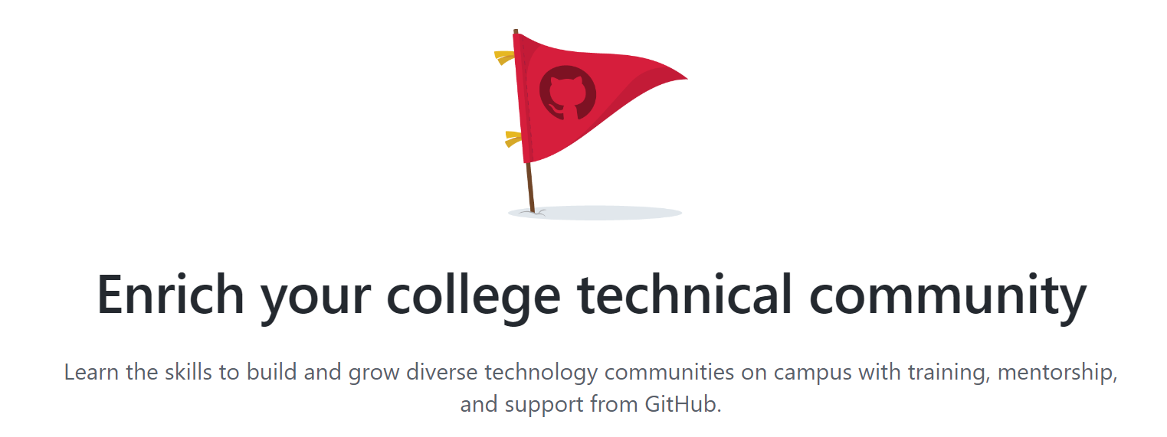
GitHub Campus Experts
Notes:
Another student opportunity you can check out is the GitHub Campus Experts program, this is basically similar with the Microsoft Learn Student Ambassadors program but just for GitHub and it is a little more competitive, they usually only take in one person per campus. But still, its worth applying to get the experience

Slide 37

Imagine Cup
Notes:
And lastly the Imagine Cup, it’s Microsoft’s yearly event where students get together to build a solution to a real world problem and make some impact. This one takes a lot of commitment, the competition lasts a few months and you have to find time to commit as you will need to plan a solution, build a solution and then pitch it.
But I think its worth joining because I don’t think you will get an opportunity like this anywhere else, you get to learn about real world problems, how to build a product, you get mentorship from industrial experts, network with a lot of people and a chance to accelerate your career

Slide 38
Share it!
Notes:
Once you have done something, the last step is to share it

Slide 39

Linkedin
Notes:
And you can do that through LinkedIn
If you don’t have an account yet, make one asap, it is essential for your career, grow your network and share with them the results of your work, for example let your network know that you’ve attended this Student Meetup
Linkedin is also a great place to find out job opportunities, make sure to keep your profile updated and once you’ve posted enough, recruiters will start approaching you left and right

Slide 40
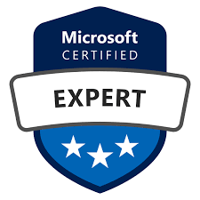


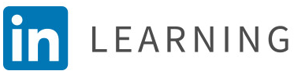
Takeaway
Do something
With
Learn something
Share it
Notes:
Alright, we reached the end of the talk, what should you takeaway from this talk?
Here are the steps you can take to succeed as a student developer
Learn something, technical knowledge, non technical knowledge or essential skills, mix and match from different platforms
Do something, work on a personal project or work on making impact through the student opportunities
Use the tools to help out with your projects, you have vsc to write your code, GitHub to store your code, student pack for resources
Share it with the public, can be to your network on LinkedIn or create content for your local community through the student opportunities
Repeat this enough and congratulations, you passed the CV screening, but for real though, the experience and skills you get from doing this process should be able to help you pass any interviews easily

Slide 41
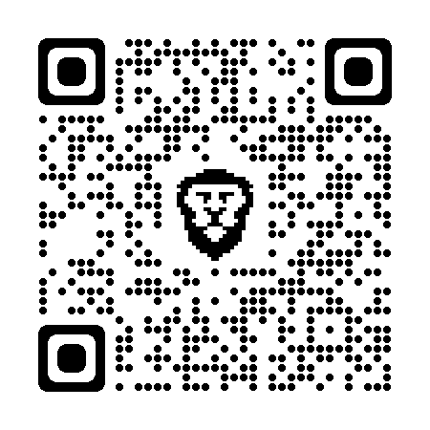
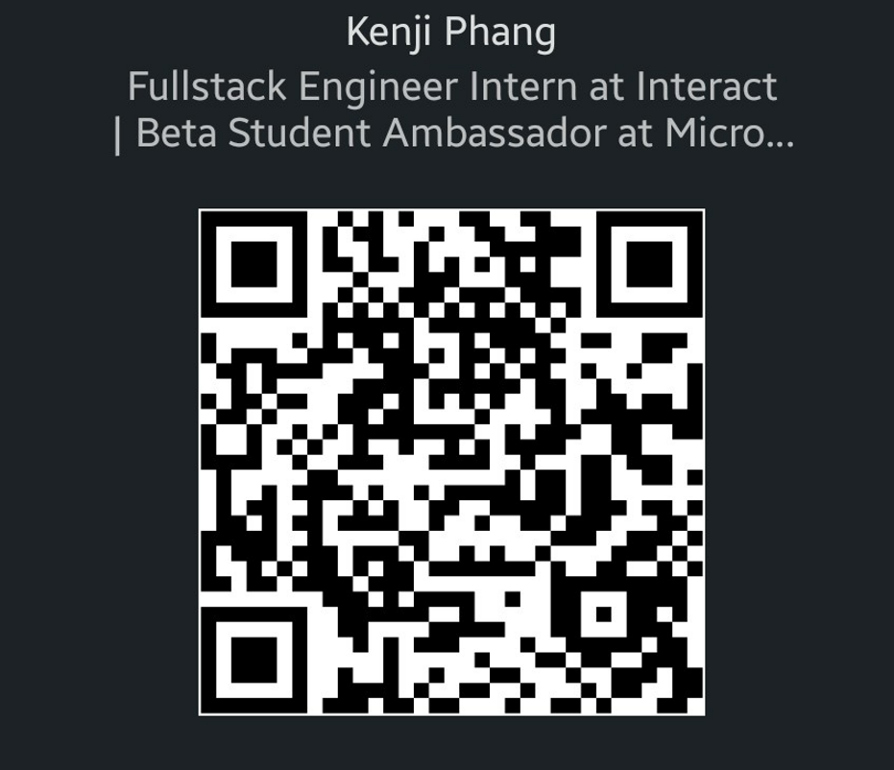
Thanks for listening
GitHub Repo
LinkedIn
Notes:
All right, that’s 20mins from me, I’ve made a GitHub Repo containing the contents of this talk, feel free to scan the QR here and take a look at it. if you all have any questions about any of the tools, the ambassadorship program or anything else, feel free to just ask me, here is my Linkedin if you want to connect. Thanks for listening to my talk

